Slide 1
UNIT-V
ARM PROCESSOR

Slide 2
EMBEDDED PROCESSORS
Embedded processors can be broken into two broad categories: ordinary microprocessors (μP) and microcontrollers (μC), which have many more peripherals on chip, reducing cost and size.
Contrasting to the personal computer and server markets, a fairly large number of basic CPU architectures are used.
There are Von Neumann as well as various degrees of Harvard architectures, RISC as well as non-RISC and VLIW.
Word lengths vary from 4-bit to 64-bits and beyond (mainly in DSP processors) although the most typical remain 8/16-bit.
Most architecture comes in a large number of different variants and shapes, many of which are also manufactured by several different companies. e.g ARM

Slide 3
INTRODUCTION:
A Reduced Instruction Set Computer is a type of microprocessor architecture that utilizes a small, highly-optimized set of instructions rather than the highly-specialized set of instructions typically found in other architectures.
RISC is an alternative to the Complex Instruction Set Computing (CISC) architecture and is often considered the most efficient CPU architecture technology available today.
With RISC, a central processing unit (CPU) implements the processor design principle of simplified instructions that can do less but can execute more rapidly.
The result is improved performance. A key RISC feature is that it allows developers to increase the register set and increase internal parallelism by increasing the number of parallel threads executed by the CPU and increasing the speed of the CPU's executing instructions.

Slide 4
ARM, or “Advanced RISC Machine” is a specific family of instruction set architecture that’s based on reduced instruction set architecture developed by Arm Ltd.
Processors based on this architecture are common in smartphones, tablets, laptops, gaming consoles and desktops, as well as a growing number of other intelligent devices

Slide 5

ARM PROCESSOR
The ARM processor is widely used in cell phones and many other systems.

Slide 6
ARM PROCESSOR:
ARM is actually a family of RISC architectures that have been developed over many years.
ARM does not manufacture its own VLSI devices; rather, it licenses its architecture to companies who either manufacture the CPU itself or integrate the ARM processor into a larger system.
The textual description of instructions, as opposed to their binary representation, is called an assembly language.
ARM instructions are written one per line, starting after the first column. Comments begin with a semicolon and continue to the end of the line.
A label, which gives a name to a memory location, comes at the beginning of the line, starting in the first column

Slide 7
Processor and Memory Organization
The ARM architecture supports two basic types of data:
The standard ARM word is 32 bits long.
The word may be divided into four 8-bit bytes
ARM7 allows addresses up to 32 bits long.An address refers to a byte,not a word.Therefore, the word 0 in the ARM address space is at location 0, the word 1 is at 4, the word 2 is at 8,and so on.

Slide 8
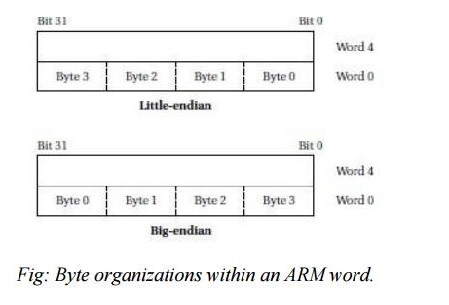
The ARM processor can be configured at power-up to address the bytes in a word in either
little-endian mode (with the lowest-order byte residing in the low-order bits of the word)
big-endian mode (the lowest-order byte stored in the highest bits of the word),

Slide 9
Data Operations:
Arithmetic and logical operations in C are performed in variables. Variables are implemented as memory locations.
Sample fragment of C code with data declarations and several assignment statements. The variables a, b, c, x, y, and z all become data locations in memory.
In most cases data are kept relatively separate from instructions in the program’s memory image.
In the ARM processor, arithmetic and logical operations cannot be performed directly on memory locations. While some processors allow such operations to directly reference main memory,
ARM is a load-store architecture—data operands must first be loaded into the CPU and then stored back to main memory to save the results

Slide 10
Following Fig shows the registers in the basic ARM programming model.
ARM has 16 general-purpose registers, r0 through r15.
Except for r15, they are identical—any operation that can be done on one of them can be done on the other one also.
The r15 register has the same capabilities as the other registers, but it is also used as the program counter

Slide 11
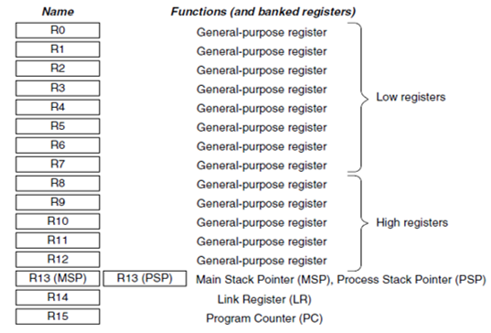
Arm registers

Slide 12
R0–R12: General-Purpose Registers: R0–R12 are 32-bit general-purpose registers for data operations. 16-bit Thumb instructions can only access a subset of these registers (low registers, R0–R7).
R13: Stack Pointers: The Cortex-M3 contains two stack pointers (R13). They are banked so that only one is visible at a time. The two stack pointers are as follows:
Main Stack Pointer (MSP): The default stack pointer, used by the operating system (OS) kernel and exception handlers
Process Stack Pointer (PSP): Used by user application code
The lowest 2 bits of the stack pointers are always 0, which means they are always word aligned.
R14: The Link Register: When a subroutine is called, the return address is stored in the link register.
R15: The Program Counter: The program counter is the current program address. This register can be written to control the program flow.

Slide 13
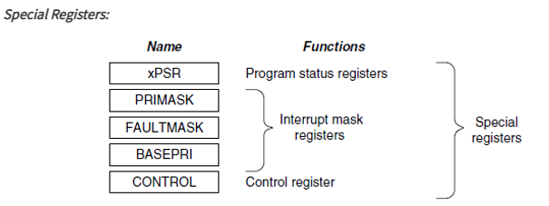
Arm processor Special function registers
The Cortex-M3 processor also has a number of special registers. They are as follows:
Program Status registers (PSRs)
Interrupt Mask registers (PRIMASK, FAULTMASK, and BASEPRI)
Control register (CONTROL)

Slide 14
The functions of special register are as follows:
xPSR: Provide arithmetic and logic processing flags (zero flag and carry flag), execution status, and current executing interrupt number.
The PSRs are subdivided into three status registers:
a. Application Program Status register (APSR)
b. Interrupt Program Status register (IPSR)
c. Execution Program Status register (EPSR)

Slide 15
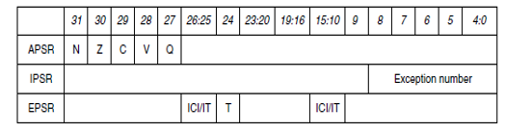
PSR

Slide 16
N: Negative
Z: Zero
C: Carry/borrow
V: Overflow
Q: Sticky saturation flag
ICI/IT: Interrupt-Continuable Instruction (ICI) bits, IF-THEN instruction status bit
T: Thumb state, always 1; trying to clear this bit will cause a fault exception

Slide 17
PRIMASK: Disable all interrupts except the non maskable interrupt (NMI) and hard fault. Default value of this 1 bit register is 0, which means that no masking is set.
FAULTMASK: Disable all interrupts except the NMI. Default value of this 1 bit register is 0, which means that no masking is set.
BASEPRI: Disable all interrupts of specific priority level or lower priority level. Default value of this 1 byte register is 0.
CONTROL: Define privileged status and stack pointer selection. The register has two bits:
CONTROL [1] Stack status: 1 = Alternate stack is used0 = Default stack (MSP) is used
CONTROL [0]: 0 = Privileged in thread mode1 = User state in thread mode

Slide 18
Instruction Sets in ARM
Following figure summarizes the ARM move instructions. The instruction MOV r0, r1 sets the value of r0 to the current value of r1. The MVN instruction complements the operand bits (one’s complement) during the move.

Slide 19
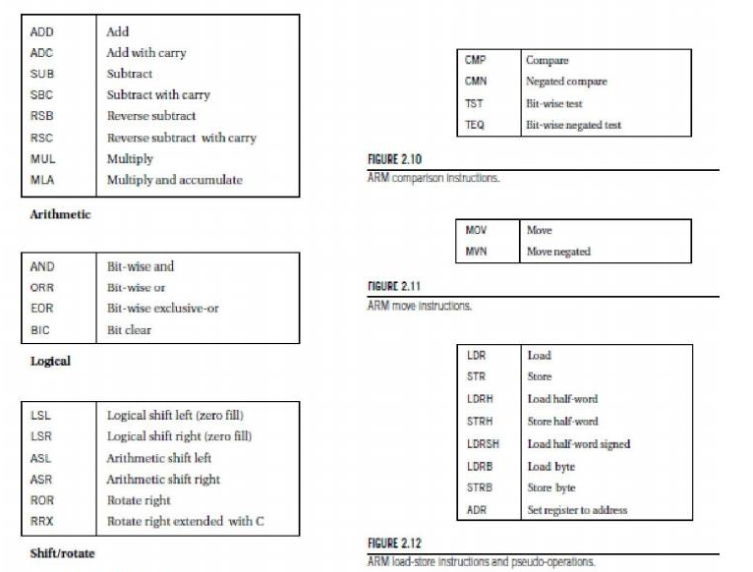

Slide 20
LDRB and STRB load and store bytes rather than whole words,while LDRH and SDRH operate on half-words and LDRSH extends the sign bit on loading.
An ARM address may be 32 bits long.
The ARM load and store instructions do not directly refer to main memory addresses, since a 32-bit address would not fit into an instruction that included an opcode and operands. Instead, the ARM uses register-indirect addressing.

Slide 21
C assignments in ARM instructions
The semicolon (;) begins a comment after an instruction, which continues to the end of that line. The statement
x = (a +b) _ c;
Can be implemented by using r0 for a, r1 for b, r2 for c, and r3 for x . We also need registers for indirect addressing.
In this case, we will reuse the same indirect addressing register, r4, for each variable load. The code must load the values of a, b, and c into these registers before performing the arithmetic, and it must store the value of x back to memory when it is done.
This code performs the following necessary steps:
ADR r4,a ; get address for a
LDR r0,[r4] ; get value of a
ADR r4,b ; get address for b, reusing r4
LDR r1,[r4] ; load value of b
ADD r3,r0,r1 ; set intermediate result for x to a + b
ADR r4,c ; get address for c
LDR r2,[r4] ; get value of c
SUB r3,r3,r2 ; complete computation of x
ADR r4,x ; get address for x
STR r3,[r4] ; store x at proper location

Slide 22
Flow of Control
The B (branch) instruction is the basic mechanism in ARM for changing the flow of control. The address that is the destination of the branch is often called the branch target.
Branches are PC-relative—the branch specifies the offset from the current PC value to the branch target.
The offset is in words, but because the ARM is byte addressable, the offset is multiplied by four (shifted left two bits, actually) to form a byte address.
Thus, the instruction B #100 ,will add 400 to the current PC value.

Slide 23
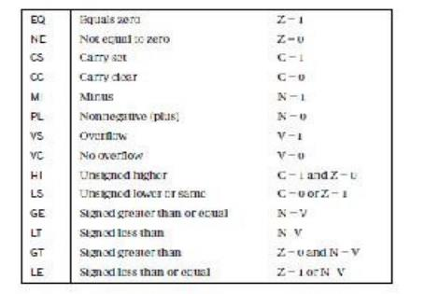

Slide 24
Implementing an if statement in ARM
We will use the following if statement as an example:
if (a < b)
{
x = 5;
y = c + d;
}
else x = c – d;

Slide 25
The implementation uses two blocks of code, one for the true case and another for the false case.
A branch may either fall through to the true case or branch to the false case:
Compute and test the condition ADR r4,a ; get address for a
LDR r0,[r4] ; get value of a ADR r4,b ; get address for b
LDR r1,[r4] ; get value of b CMP r0, r1 ; compare a < b
BGE fblock ; if a >= b, take branch the true block follows
MOV r0,#5 ; generate value for x
ADR r4,x ; get address for x
STR r0,[r4] ; store value of x
ADR r4,c ; get address for c
LDR r0,[r4] ; get value of c
ADR r4,d ; get address for d
LDR r1,[r4] ; get value of d
ADD r0,r0,r1 ; compute c + d
ADR r4,y ; get address for y STR r0,[r4] ; store value of y

Slide 26
B after ; branch around the false block ; the false block follows
fblock ADR r4,c ; get address for c
LDR r0,[r4] ; get value of c
ADR r4,d ; get address for d
LDR r1,[r4] ; get value of d
SUB r0,r0,r1 ; compute c – d
ADR r4,x ; get address for x
STR r0,[r4] ; store value of x after ... ; code after the if statement

